Slide 1
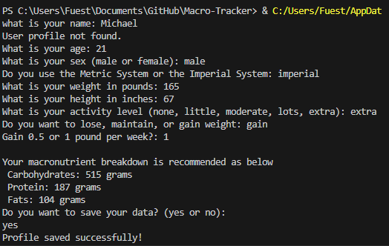
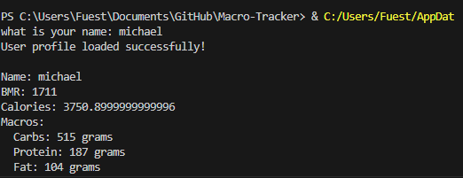
MacroTracker
An easy way to calculate your calories and macronutrient intake for the day!
By: Michael Fueston

